Slide 1
MOBILE APPLICATION DEVELOPMENT

Slide 2
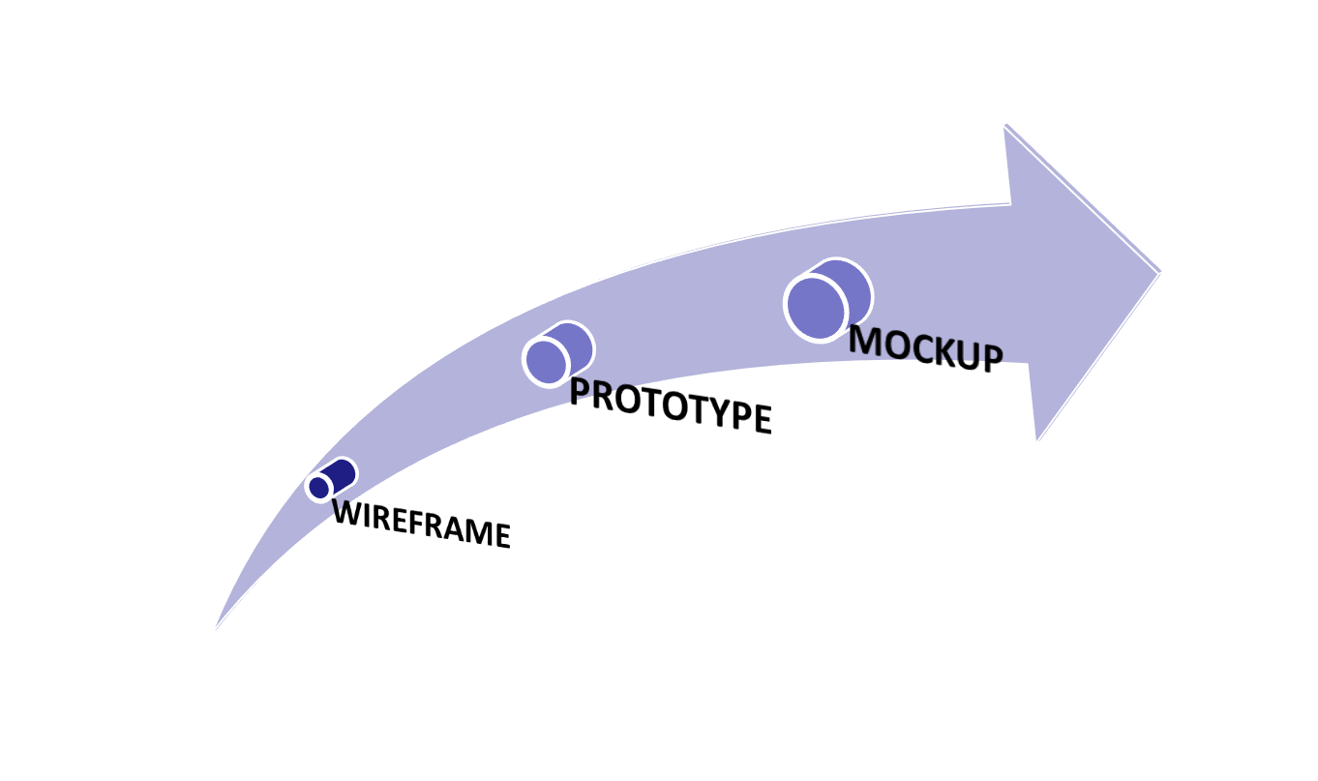
The Design Process (UX UI)
LOW FIDELITY WIREFRAME TO HIGH FIDELITY PROTOTYPE

Slide 3
The Design Process (UX UI)
Best Analogy
The wireframe is the skeleton; the barebones structure of the product. The prototype is the brain; the organ that decides how the human should move and interact with those around him/her. The mockup is the skin, hair, and facial features, or brand, that make the human instantly recognizable.

Slide 4
Wire framing
A practice used by UX designer which help in defining and planning information hierarchy of website app or product design.
Focus:
  How the designer or client wants the user to process information on a site?
  How a user interacts with interface, through the positioning of buttons and menus?
A plain black and white design for the screen you need to know where all the information is going before building anything with code.
  Lets you plan the layout and interaction of your interface
Without the distractions of colors, typeface choices or text
If a user doesn’t know where to go on a plain hand-drawn diagram, then it is irrelevant what colors or fancy text eventually get used.
  A button or call to action needs to be clear to the user even it’s not brightly colored and flashing.

Slide 5
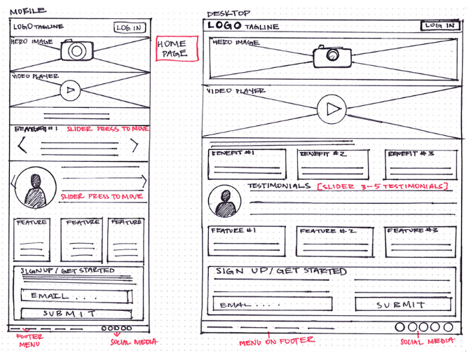
Wire framing

Slide 6
Wire framing
What are the intended users and business goals when interacting with this page?
What users want to achieve?
What actions business wants the user to complete?
  Adding a content to the shopping cart
How can you organize the content to support these goals?
Which information should be more prominent?
What buttons or the touchpoints does the user need in order to complete the desired actions?
  What is the main message in the logo should go?
  What user should see when landing on the page?
What would the user expect to see at the certain areas of the page?

Slide 7
Wire framing
YOU ARE JUST DESIGNING
THE BUILDING BLOCKS
THE BARE BONES
SO KEEP IT SIMPLE
SKETCH DONOT DRAW

Slide 8
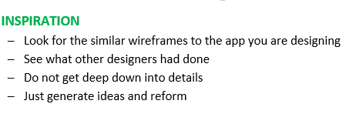
Wire framing
Done with market research, competitor and customer analysis
START DESIGNING
Sketch
Refine your idea
  Using pen or paper
    Easy to edit

Slide 9
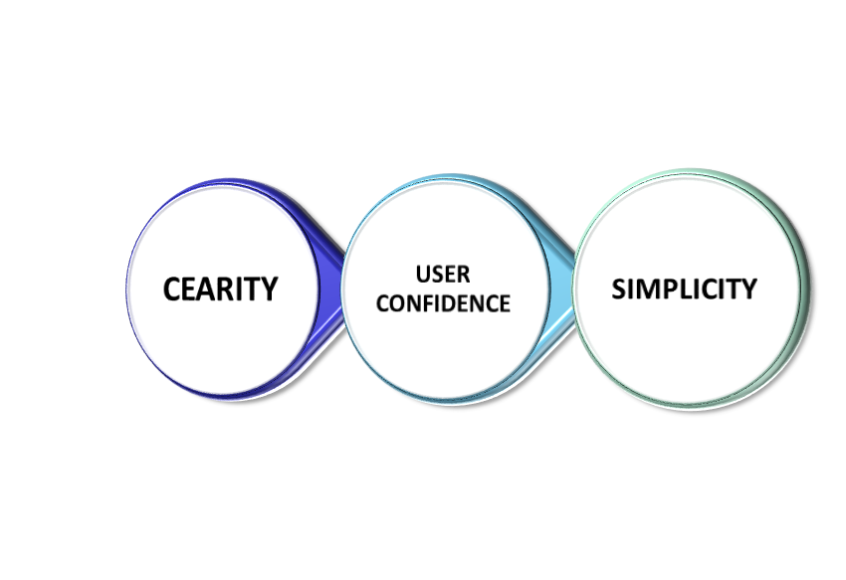
Wire framing
Foundations are in place
FILL IN THE DETAILS
Define usability convention
  TOP to BOTTOM
  LEFT to RIGHT
    Navigation bar
    Logo
    Spacing
    Layout
    Information hierarchy
    Images to be included
      Place
      Size

Slide 10
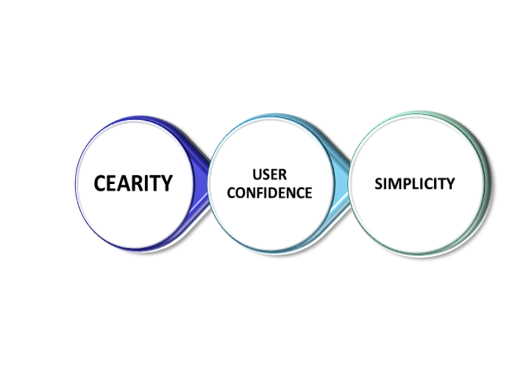
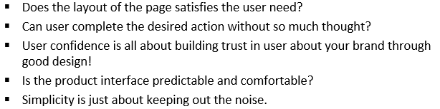
Wire framing
All the necessary details
MAP USER FLOWS
Good information architecture

Slide 11
Wire framing
At the end
user journey
must be
smooth and suave

Slide 12
Wire framing
GO Digital!
  Digital Soft wares:
    UXPin has a wide range of functionalities, but one of the best ones is how how it facilitates building responsive clickable prototypes directly in your browser.
    InVision allows you to get feedback straight from your team and users through clickable mock-ups of your site design. It’s completely free too!
    Wireframe.cc provides you with the technology to create wireframes really quickly within your browser, the online version of pen and paper.
    Balsamiq is simple and restricts you adding unnecessary colors and components
    Mockplus a handy tool with simple drag and drop functionality
    Sketck a simple and extremely useful UX tool

Slide 13
Wire framing
Complete set of wireframes
TEST YOUR WIREFRAMES
Turn them into prototype
A working model of an app or website

Slide 14
Prototyping
A low scalded version of the product, a simulation or a sample which enables you to test your idea before spending too much time and money into actual development.
  Low Fidelity Prototype
    Can be a static paper sketches, or digital drawings or webpages that are interactive and clickable.
    Dynamic for generating user feedback, allowing the user to test the interaction flow without a vast expenditure of time or resources
  High Fidelity Prototypes
    Include color, text and other content, and often take the form of a fully functioning and coded website or app.
    Used in the later stages of the design process
As both low and high-fidelity prototypes enable the user to gauge how the product might be used on a daily basis, they are key to refining the product’s usability.

Slide 15
Prototyping
Variants of prototypes
  Form:
    A hand-drawn prototype, or a digital one?
    Is it for mobile or desktop?
  Fidelity:
    How detailed and polished is the prototype?
    Is it high-fidelity or low-fidelity prototypes?
  Interactivity:
    How functional is the prototype?
    Can the user click on it or interact with it, or is it view-only?
  Lifecycle:
    Is the prototype a quick, disposable version that will be replaced with a new and improved version?
    Is it a more enduring creation that can be built and improved upon, potentially ending up as the final product?

Slide 16
Prototyping
How to? Tips and Top Does
  Choose the right type of prototype:
    Consider what stage you are at in the design process
    What time and resources available?
    Low-fidelity prototypes make sense in the early stages, but you’ll want to move on to hi-fi prototypes as you get closer to shipping your product.
  Set concrete goals:
    Have a clear idea of what you want your prototype to achieve.
    What do you want to find out when you test your prototype?
    Remember to focus on user needs, keeping your problem statement in mind at all times!
  Use the right tools:
    In digital prototyping, spend time playing around with a few of the most popular industry tools.
      Find the tool that meets your needs in terms of features and functionality
  Take action!
    Prototype when you need to!

Slide 17
Prototyping
Which? Testing
Concept testing
  In early stages of the design process
  Test out your initial concepts before actually designing them.
  Low-fidelity prototypes—a simple sketch, or even static images—can be used
  Users feel about the concept.
    Is it a product or feature they’d be interested in using?
    Does it have the potential to solve the user’s problem?
A/B testing
  Used at any stage of the design process
  Compare two different versions of a design
  Test each version on a different set of users.
  Test two different layouts,
  For example, or different copy for a certain CTA button on a certain screen
  Call-to-action (CTA) buttons are the buttons you use in your website and on your landing pages to guide users towards your goal conversion. It's the part of the landing page that the user needs to click in order to take the action you want them to take.

Slide 18
Prototyping
Which? Testing
Usability testing
  Used repeatedly throughout the design process
  How easy your design is to use.
  An observational exercise
    Recruit users to complete certain tasks, and observe them as they do so.
    Check which aspects of the design caused problems for the user,
    Which aspects appear to be user-friendly.
    Identify usability issues which you’ll seek to fix in the next iteration of your prototype
First Click Test
  Intended action whenever they land on a certain page or screen.
  First-click testing shows you what your users first steps are when they encounter an interface; in other words, where do they click first?
  Determine which visual elements and content should take priority, where buttons, icons, and menu items should be located, as well as the kind of language you should use for buttons and labels

Slide 19
Prototyping
Which? Testing
Tree testing
  Tells how user-friendly it really is
  Present the user with a “tree” of information—representative of how your site menus would be laid out
  Ask them to find specific items.
  If users struggle to locate certain information, you’ll need to rethink your information architecture
  Often conducted as a remote, unmoderated study
  Can also be done in person using paper prototypes

Slide 20
Prototyping
How to? Testing
Set an objective:
  What do you want to learn from your user tests?
  What question do you hope to answer?
  For example: If you’re designing an ecommerce app, your objective might be to test how easy it is for your users to add an item to their wish list.
Build your prototype:
  Get to know what you want to test?
  In the very early stages of testing an idea, stick to low-fidelity prototypes.
  Want to test the finer details, such as information architecture or microcopy, go for mid and high-fidelity prototypes.
Create a plan:
  Include your objective or question; the method you intend to use to test your prototype
  Number of users you’ll test on
  List of all the equipment you’ll need
  How will you document and measure your findings?
  Create a script in order to keep the session focused

Slide 21
Prototyping
How to? Testing
Recruit participants:
  Spend a bit of time identifying some key criteria to define the users going to be your target audience.
  For example if you are designing an app for over 50s, it wouldn’t make sense to run user tests with a group of 18 year-olds.
Gather all the necessary equipment:
  Refer back to your plan and make sure everything you need to conduct the test is hemmed in
  For example screen recording software if you’re conducting remote testing
  pens and paper for taking notes
Document your findings:
  For each user test, document your findings.
  Maintain a thorough record of each test in order to analyze your observations and compare the results of each session

Slide 22
Prototyping
Some useful interactions: (Considering native apps)
  Tap and Double Tap - Pretty much the same as clicking with your mouse
  Swipe - A swipe is used for scrolling up or down long pages. Also for deleting content in a list
  Flick - A shorter swipe of your finger. Think of swiping through images on your phones photo library.
  Press and Hold - Press and hold interaction is most commonly used to rearrange apps on a phones home screen. Think of it as an interaction that allows for initiating other actions.
  Pinch to Zoom - This was a very novel interaction when introduced by Apple. It allows users to zoom in and out of images by pinching two fingers together or away from each other. It has now become ubiquitous as a way to interact with images on touch screens.
There is also 3D Touch, where the device can detect the level of pressure your finger is pressing and activate different interactions based on that pressure, but it is not supported in all apps or on all devices.

Slide 23
Prototyping
Hand in hand testing and prototyping
PUT IT IN FRONT OF REAL USER
MOCKUP
A high fidelity simulation of the finished product

Slide 24
Mockup
Delivers the visual look of the product design—including typography, iconography, color, and overall style.
Establish how the users will interpret the brand through its visual identity.
Offer a more realistic perspective to stakeholders
  Can help revealing problems that weren’t so apparent in the wire framing and prototyping stages such as color clashes or typography issues.
  With a highly detailed spectacle of visual storytelling in front of them, users don’t need to rely as much on their imaginations.
An effective way to explore the brand’s visual identity before the design decisions are made permanent with the code.

Slide 25
Prototyping
Design decisions are ready
MAKE THEM PERMANENT
CODE
Start Development

Slide 26

Development

